Slide 1
Unit 2 : Memory Organization
Memory Architecture Memory hierarchy Types of Memories : Primary Memory – DRAM, SDRAM, DDR, RDAM. ROM, PROM, EPROM, EEPROM, Cache memory Structure DMA DMA interfacing with processor Data Read/ Write process, Role of Cache memory, Virtual Memory.
By Varsha Sontakke

Slide 2
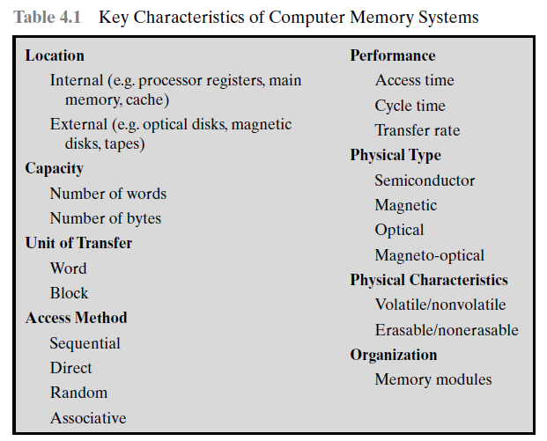
COMPUTER MEMORY SYSTEM OVERVIEW Characteristics of Memory Systems

Slide 3
1. The term location in Table 4.1 refers to whether memory is internal and external to the computer.
Internal memory is often equated with main memory. But there are other forms of internal memory.
Cache is another form of internal memory.
External memory consists of peripheral storage devices, such as disk and tape, that are accessible to the processor via I/O controllers.
2. Capacity.
For internal memory, this is typically expressed in terms of bytes (1 byte 8 bits) or words. Common word lengths are 8, 16, and 32 bits.
External memory capacity is typically expressed in terms of bytes.

Slide 4
For internal memory, the unit of transfer is equal to the number of electrical lines into and out of the memory module. For main memory, this is the number of bits read out of or written into memory at a time.
For external memory, data are often transferred in much larger units than a word, and these are referred to as blocks.
Method of accessing units of data. :
Sequential access: Memory is organized into units of data, called records. Access must be made in a specific linear sequence. Stored addressing information is used to separate records and assist in the retrieval process.
b. Direct access: As with sequential access, direct access involves a shared read–write mechanism. However, individual blocks or records have a unique address based on physical location

Slide 5
Memory characteristics
Random access: Each addressable location in memory has a unique, physically wired-in addressing mechanism. The time to access a given location is independent of the sequence of prior accesses and is constant.
Thus, any location can be selected at random and directly addressed and accessed. Main memory and some cache systems are random access.
Associative: This is a random access type of memory that enables one to make a comparison of desired bit locations within a word for a specified match.
Thus, a word is retrieved based on a portion of its contents rather than its address.
As with ordinary random-access memory, each location has its own addressing mechanism, and retrieval time is constant independent of location or prior access patterns.
Cache memories may employ associative access.

Slide 6
Access time (latency): For random-access memory, this is the time it takes to perform a read or write operation, that is, the time from the instant that an address is presented to the memory to the instant that data have been stored or made available for use.
Memory cycle time: This concept is primarily applied to random-access memory and consists of the access time plus any additional time required before a second access can commence.
This additional time may be required for transients to die out on signal lines or to regenerate data if they are read destructively.
Note that memory cycle time is concerned with the system bus, not the processor.
Transfer rate: This is the rate at which data can be transferred into or out of a memory unit. For random-access memory, it is equal to 1/(cycle time).

Slide 7
The Memory Hierarchy
To achieve greatest performance, the memory must be able to keep up with the processor.
As the CPU is executing instructions, it should not wait for the operands or instructions to be read from the memory.
For a practical system, cost of system must be reasonable.
A memory system has three basic characteristics.
Cost per bit
Capacity
Access time

Slide 8
The Memory Hierarchy
There is a trade-off among the three key characteristics of memory: namely, capacity, access time, and cost.
A variety of technologies are used to implement memory systems, and across this spectrum of technologies, the following relationships hold:
• Faster access time, greater cost per bit
• Greater capacity, smaller cost per bit
• Greater capacity, slower access time.

Slide 9
The Memory Hierarchy
The designer would like to use memory technologies that provide for large-capacity memory, both because the capacity is needed and because the cost per bit is low.
However, to meet performance requirements, the designer needs to use expensive, relatively lower-capacity memories with short access times.
The way out from the above problem is not to rely on a single memory component or technology, but to employ a memory hierarchy.

Slide 10
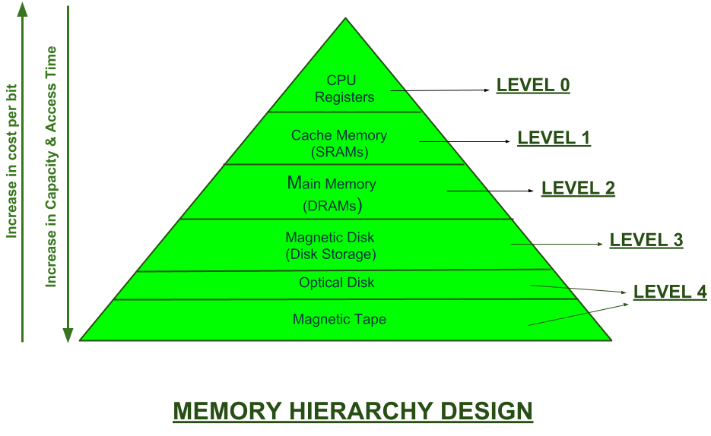
A typical memory hierarchy is shown in fig.

Slide 11
This Memory Hierarchy Design is divided into 2 main types:
External Memory or Secondary Memory – Comprising of Magnetic Disk, Optical Disk, Magnetic Tape i.e. peripheral storage devices which are accessible by the processor via I/O Module.
Internal Memory or Primary Memory – Comprising of Main Memory, Cache Memory & CPU registers. This is directly accessible by the processor.

Slide 12
As one goes down the hierarchy, the following occur:
a. Decreasing cost per bit
b. Increasing capacity
c. Increasing access time
d. Decreasing frequency of access of the memory by the processor
Thus, smaller, more expensive, faster memories are supplemented by larger, cheaper, slower memories. The key to the success of this organization is item (d):decreasing frequency of access.

Slide 13
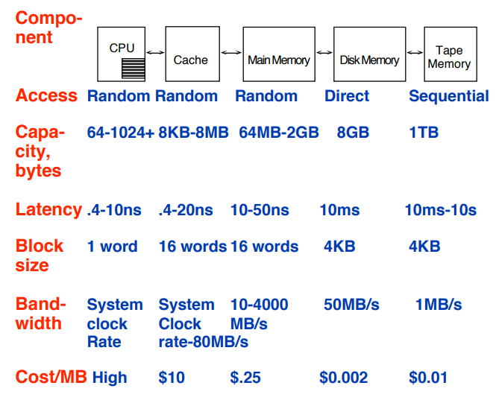

Slide 15
Semiconductor main memory
DRAM and SRAM
Table 5.1 lists the major types of semiconductor memory. The most common is referred to as random-access memory (RAM). One distinguishing characteristic of RAM is that it is possible both to read data from the memory and to write new data into the memory easily and rapidly.
Both the reading and writing are accomplished through the use of electrical signals.
The other distinguishing characteristic of RAM is that it is volatile. A RAM must be provided with a constant power supply. If the power is interrupted, then the data are lost. Thus, RAM can be used only as temporary storage.
The two traditional forms of RAM used in computers are DRAM and SRAM

Slide 16
DYNAMIC RAM
RAM technology is divided into two technologies: dynamic and static. A dynamic RAM (DRAM) is made with cells that store data as charge on capacitors.
The presence or absence of charge in a capacitor is interpreted as a binary 1 or 0. Because capacitors have a natural tendency to discharge, dynamic RAMs require periodic charge refreshing to maintain data storage.

Slide 17
Dynamic RAM CELL

Slide 18
Figure 5.2a is a typical DRAM structure for an individual cell that stores 1 bit.
The address line is activated when the bit value from this cell is to be read or written.
The transistor acts as a switch that is closed (allowing current to flow) if a voltage
is applied to the address line and open (no current flows) if no voltage is present on
the address line.
For the write operation, a voltage signal is applied to the bit line; a high voltage
represents 1, and a low voltage represents 0. A signal is then applied to the address
line, allowing a charge to be transferred to the capacitor.
For the read operation, when the address line is selected, the transistor turns on
and the charge stored on the capacitor is fed out onto a bit line and to a sense
amplifier.
The sense amplifier compares the capacitor voltage to a reference value and
determines if the cell contains a logic 1 or a logic 0. The readout from the cell
discharges the capacitor, which must be restored to complete the operation.

Slide 19
SRAM Design

Slide 20
Types of ROM
Read-only memory (ROM) contains a permanent pattern of data that cannot be changed.
A ROM is nonvolatile; that is, no power source is required to maintain the bit values in memory.
While it is possible to read a ROM, it is not possible to write new data into it.
When only a small number of ROMs with a particular memory content is needed, a less expensive alternative is the programmable ROM (PROM). PROM is nonvolatile and may be written into only once. For the PROM, the writing process is performed electrically and may be performed by a supplier or. customer at a time later than the original chip fabrication. Special equipment is required for the writing or “programming” process
PROMs provide flexibility and convenience.
There are three common forms of read-mostly memory: EPROM, EEPROM, and flash memory
OTP: ONE TIME PROGRAMMABLE

Slide 21
Erasable programmable read-only memory (EPROM)
The optically erasable programmable read-only memory (EPROM) is read and written electrically, as with PROM.
However, before a write operation, all the storage cells must be erased to the same initial state by exposure of the packaged chip to ultraviolet radiation.
Erasure is performed by shining an intense ultraviolet light through a window that is designed into the memory chip.
This erasure process can be performed repeatedly; each erasure can take as much as 20 minutes to perform.
Thus, the EPROM can be altered multiple times and, like the ROM and PROM, holds its data virtually indefinitely.
For comparable amounts of storage, the EPROM is more expensive than PROM, but it has the advantage of the multiple update capability.

Slide 22
Electrically Erasable Programmable read-only memory (EEPROM).
A more attractive form of read-mostly memory is electrically erasable programmable read-only memory (EEPROM).
This is a read-mostly memory that can be written into at any time without erasing prior contents; only the byte or bytes addressed are updated.
The write operation takes considerably longer than the read operation, on the order of several hundred microseconds per byte.
The EEPROM combines the advantage of nonvolatility with the flexibility of being updatable in place, using ordinary bus control, address, and data lines.
EEPROM is more expensive than EPROM and also is less dense, supporting fewer bits per chip.

Slide 23
Flash memory
Flash memory is intermediate between EPROM and EEPROM in both cost and functionality.
Like EEPROM, flash memory uses an electrical erasing technology.
An entire flash memory can be erased in one or a few seconds, which is much faster than EPROM.
In addition, it is possible to erase just blocks of memory rather than an entire chip.
Flash memory gets its name because the microchip is organized so that a section of memory cells are erased in a single action or “flash.”

Slide 24
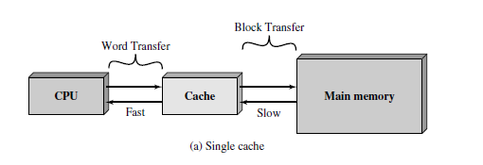
CACHE MEMORY : CACHE MEMORY PRINCIPLES
Cache memory is intended to give memory speed approaching that of the fastest memories available, and at the same time provide a large memory size at the price of less expensive types of semiconductor memories.
The concept is illustrated in Figure 4.3a.
There is a relatively large and slow main memory together with a smaller, faster cache memory. The cache contains a copy of portions of main memory.
When the processor attempts to read a word of memory, a check is made to

Slide 25
determine if the word is in the cache.
If so, the word is delivered to the processor. If not, a block of main memory, consisting of some fixed number of words, is read into the cache and then the word is delivered to the processor.
Figure 4.3b depicts the use of multiple levels of cache. The L2 cache is slower and typically larger than the L1 cache, and the L3 cache is slower and typically larger than the L2 cache

Slide 26
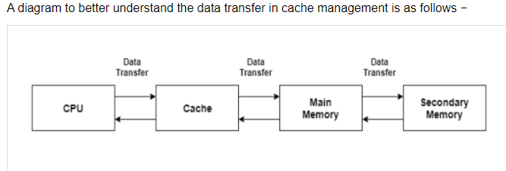
Cache is a type of memory that is used to increase the speed of data access. Normally, the data required for any process resides in the main memory. However, it is transferred to the cache memory temporarily if it is used frequently enough.
A diagram to better understand the data transfer in cache management is as follows −

Slide 27
Cache Performance
The cache performance can be explained using the following steps −
If a process needs some data, it first searches in the cache memory. If the data is available in the cache, this is termed as a cache hit and the data is accessed as required.
If the data is not in the cache then it is termed as a cache miss. Then the data is obtained from the main memory. After that the data is transferred to the cache memory under the assumption that it will be needed again.
The performance of the cache is measured using the hit ratio. It is the number of cache hits divided by the total cache accesses. The formula for this is:

Slide 28
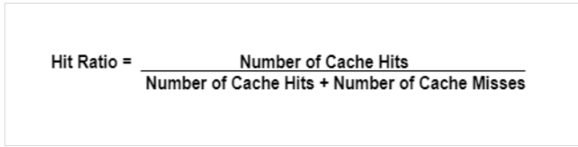
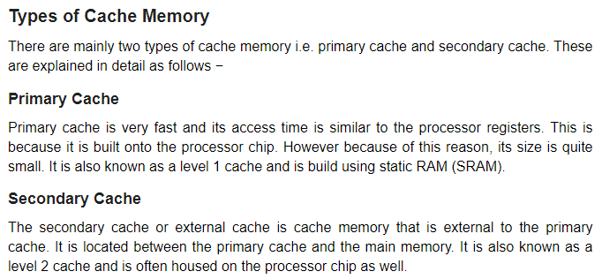

Slide 29
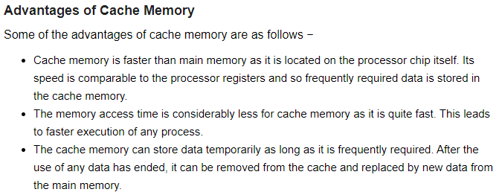

Slide 30
Disadvantages of Cache Memory
Some of the disadvantages of cache memory are as follows −
Since the cache memory is quite fast, it is extremely useful in any computer system. However, it is also quite expensive.
The cache is memory expensive as observed from the previous point. Also, it is located directly on the processor chip. Because of these reasons, it has a limited capacity and is much smaller than main memory.

Slide 31
Virtual memory
A computer can address more memory than the amount physically installed on the system. This extra memory is actually called virtual memory and it is a section of a hard disk that's set up to emulate the computer's RAM.
The main visible advantage of this scheme is that programs can be larger than physical memory.
In essence, virtual memory is a facility that allows programs to address memory from a logical point of view, without regard to the amount of main memory physically available.
When virtual memory is used, the address fields of machine instructions contain virtual addresses. For reads to and writes from main memory, a hardware memory management unit (MMU) translates each virtual address into a physical address in main memory

Slide 33
How Virtual Memory Works?
In modern word, virtual memory has become quite common these days. In this scheme, whenever some pages needs to be loaded in the main memory for the execution and the memory is not available for those many pages, then in that case, instead of stopping the pages from entering in the main memory, the OS search for the RAM area that are least used in the recent times or that are not referenced and copy that into the secondary memory to make the space for the new pages in the main memory.
Since all this procedure happens automatically, therefore it makes the computer feel like it is having the unlimited RAM.

Slide 34
Virtual memory uses hardware and software to allow a computer to compensate for physical memory shortages, by temporarily transferring data from random access memory (RAM) to disk storage. In essence, virtual memory allows a computer to treat secondary memory
Today, most PCs come with up to around 4 GB of RAM. However, sometimes this isn't enough to run all the programs a user might want to use at once. This is where virtual memory comes in. Virtual memory can be used to swap data that has not been used recently -- and move it over to a storage device like a hard drive. This will free up more space on the RAM as though it were the main memory.
Virtual memory is important for improving system performance, multitasking, using large programs and flexibility.

Slide 35
Virtual memory & Cache memory
1 Definition : For Virtual memory as mentioned above Virtual memory is not a memory but a technique to increase the actual memory of the system.
On other hand Cache memory is actual memory unit which supports the main memory which as result increases the accessing speed of CPU.
2 Type: Virtual memory is not a memory unit while it is a technique in order to increase the actual memory of the system.
On other hand Cache memory is actual memory unit.
3 Size: Virtual memory is large in size as compare to that of cache memory.On other hand Cache memory is smaller in size as compare to that of virtual memory.
4 Data storage: In case of Virtual memory no data is get stored in this memory for increasing speed of accessing the data.
On other hand in case of cache memory application first fetched from main memory then its copy get stored in cache memory so that from next time application get fetched from cache memory not from main memory which increasing speed of accessing the data.
5 Management Virtual memory is mainly manages by operating system of the system.
While cache memory is manages by the hardware of the system.

Slide 36
Advantages of Virtual Memory
The degree of Multiprogramming will be increased.
User can run large application with less real RAM.
There is no need to buy more memory RAMs.
Disadvantages of Virtual Memory
The system becomes slower since swapping takes time.
It takes more time in switching between applications.
The user will have the lesser hard disk space for its use.

Slide 37
DIRECT MEMORY ACCESS
DMA involves an additional module on the system bus.
The DMA is capable of taking over control of the system from the processor. It needs to do this to transfer data to and from memory over the system bus.
For this purpose, the DMA module must use the bus only when the processor does not need it, or it must force the processor to suspend operation temporarily.
The latter technique is more common and is referred to as cycle stealing, because the DMA module in effect steals a bus cycle.
When the processor wishes to read or write a block of data, it issues a command to the DMA module, by sending to the DMA module the following information:

Slide 38
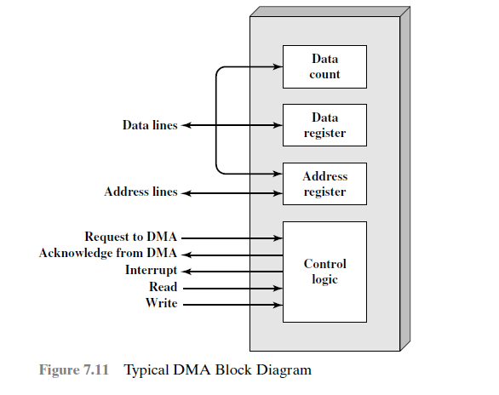

Slide 39
DIRECT MEMORY ACCESS FUNCTION
1. Whether a read or write is requested, using the read or write control line between the processor and the DMA module
2.The address of the I/O device involved, communicated on the data lines
3. The starting location in memory to read from or write to, communicated on the data lines and stored by the DMA module in its address register
4. The number of words to be read or written, again communicated via the data lines and stored in the data count register
The processor then continues with other work. It has delegated this I/O operation to the DMA module.
The DMA module transfers the entire block of data, one word at a time, directly to or from memory, without going through the processor.
When the transfer is complete, the DMA module sends an interrupt signal to the processor.
Thus, the processor is involved only at the beginning and end of the transfer

Slide 40
Supplementary links:
https://archive.nptel.ac.in/courses/106/105/106105163/
https://www.youtube.com/watch?v=_eAL-v5oNOw
https://www.geeksforgeeks.org/memory-hierarchy-design-and-its-characteristics
https://www.geeksforgeeks.org/random-access-memory-ram-and-read-only-memory-rom/
https://www.geeksforgeeks.org/direct-memory-access-dma-controller-in-computer-architecture

Slide 41
Thank You

